Slide 1
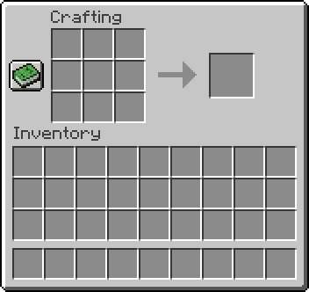

Pillars:
Uncompromising survival & world exploration with the classic assassination from previous franchises
dark and whimsical visuals in a 3D open world with a space background
randomly generated space terrain, 30% travelling through space and terrain 30% crafting new weapons 30% assassinating enemies 10% fun

Slide 2

Gameplay description :
Gameplay includes traveling trough different worlds in space. it will be a single player game where you
Enter a strange and unexplored space full of strange creatures, dangers and surprises. Find and craft new deadly weapons to kill enemies with

